Slide 1
Risk Pool Seminar Trends & impact
Dan Smereck, managing director

Slide 2
seminar Introduction
Investment income:
Is a cornerstone to the risk transfer business model, and maximizing investment income can mean the difference between remaining competitive or losing members to aggressive pricing.
How much can you expect to earn?
How much risk are you willing to prudently take?

Slide 3
Investment Performance Objectives
Where do you fall on this objective continuum and why?
Book yield
‘or’
Income Only
Constrained total return
Total return
Most Risk Pools & Insurers

Slide 4
Investments are people-driven

Slide 5
industrial revolutions
The rise of mechanical power
The advent of electricity & communication
The digital age & development of modern computing
Now – building & extending the impact of digitization in new and/or unanticipated ways
Source: World Economic Forum

Slide 6
global
Hard trends

Slide 7
Hard trends – global
Demographic
Government regulation
technology

Slide 8
global hard Trend #1 - demographic
Source: Research Affiliates, LLC based on data from United Nations

Slide 9
global hard Trend #1 – GDP Impact

Slide 10
Global hard Trend #2 – regulatory
Renewable energy use increasing
Cyber-crime policy evolution
Accelerating use of high speed data analytics for auditing & compliance

Slide 11
Global hard Trend #3 - technology
Increasing use of mobile applications
Increasing use of cloud & virtualization services
Increasing use of networked sensors & machines

Slide 12
Technology hard trend - focus
Processing power
Digital storage
bandwidth
Source for Graphic: Ray Kurzweil, DFJ

Slide 13
Blockchain innovation – “Trust the SYSTEM, NOT The USERS”
Source: McKinsey Global Institute

Slide 15
Technology Trends – Market Cap
Source: VisualCapitalist.com

Slide 16
Capital markets
Hard trends

Slide 17
Hard trends – capital markets
Globalization continues
Technology innovation continues to augment & disrupt markets
World financial leverage increasing

Slide 18
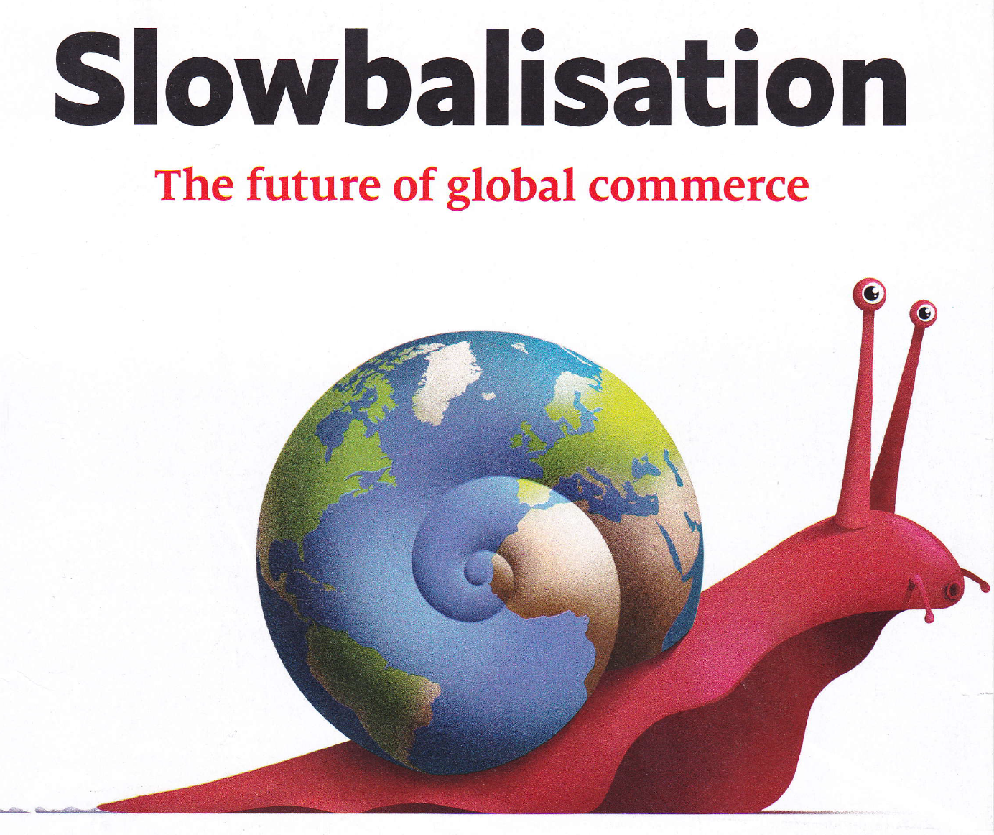
Source: The Economist, January 26th, 2019

Slide 19
World economy - $80 Trillion
Source: VisualCapitalist.com

Slide 20
Global GDP Growth 2019
Source: VisualCapitalist, IMF, Standard Chartered

Slide 21
Global flows – trade, finance, & data
Source: McKinsey Global Institute

Slide 22
Globalization: then vs. Now
Source: McKinsey Global Institute

Slide 23
150 years of us employment - sectors
Source: IPUMS USA 2017, US Bureau of Labor Statistics, McKinsey Global Institute Analysis

Slide 24
Global debt
Source: Institute of International Finance

Slide 25
Global bond market
$109 Trillion
Largest investment exposure for risk pools
Source: J.P. Morgan Asset Management

Slide 26
u.s. bond market
Source: J.P. Morgan Asset Management

Slide 27
U.S. Debt Growth – MINI Case

Slide 28
Global equity market
$85 trillion
Source: World Federation of Exchanges, SIFMA

Slide 29
u.s. equity market
Source: J.P. Morgan Asset Management

Slide 30
Investment management
Hard trends

Slide 31
Hard trends – investment management
Robo-advisor & artificial intelligence
Rise of passive investing & falling fees
Looking beyond conventional investment opportunities
Evolution of advice/education/service model
lower expected returns…

Slide 32
Robo-advisors
Source: Financial Samurai

Slide 33
Passive investing
2007
2017
Source: Investment Company Institute

Slide 34
Shrinking equity market & private equity

Slide 35
Returns – Time Horizon
1987-2018
2000-2018
100% US Stocks +9.76%
100% US Fixed Income +5.78%
50% / 50% +8.14%
100% HY Fixed Income +6.92%
100% US Stocks +5.15%
100% US Fixed Income +4.61%
50% / 50% +5.37%
100% HY Fixed Income +5.59%
2018
100% US Stocks -5.26%
100% US Fixed Income -0.13%
Source: Portfolio Visualizer

Slide 36
Return/risk expectations
6%
4%
Source: Research Affiliates

Slide 37
Where’s the Yield

Slide 38
Governmental Risk pooling
Hard trends

Slide 39
Hard trends – risk pools
Aging workforce – knowledge/wisdom transfer
Increased responsibilities of local government
Creative coverage & risk management solutions
Increased use of technology will empower risk pools
Collaboration will continue & accelerate

Slide 40
Hard trends – risk pools
What did I miss?

Slide 41
The future is still about relationships to be elevated by technology…

Slide 42
Now what?

Slide 43
Saa risk pool clients

Slide 44
considerations
how is your investment process addressing these trends?
Asset allocation (Yield vs. Growth)
Enterprise risk management modeling vs. culture
Board/staff education
(data vs. information vs. knowledge)
Investment policy flexibility
Captive formation

Slide 45
Considerations #2
how is your investment process addressing these trends?
Staffing
Internal
Investment manager(s)
Investment advisors
Investment manager Technology platform & flexibility
Investment accounting & reporting

